Slide 1

BoA python project
Natalie Wu and Amélie Mattheus

Slide 2
API
Pokémon -> Star wars -> anime
Downloading new API

Slide 3
Game principle
A small game where players compare stats, similar to the Top Trumps card game.
The basic flow of the games is:
Player 1 is given two random characters with different stats
Player 1 has to select one of the characters
Player 1 selects their chosen character's stats
Another random character is selected for Player 2
Player 2 has to select the character's stats to compete with Player 1
The stats of the two characters are compared
The player with the stat higher than their opponent wins
Built using Manga API:
documentation - https://jikan.docs.apiary.io/#

Slide 4
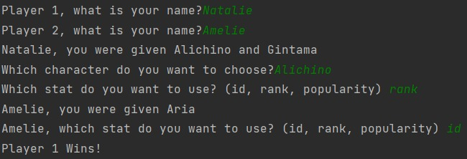
Game
Two people can play

Slide 5
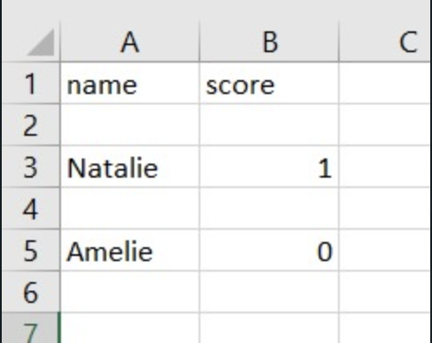
Score file

Slide 6
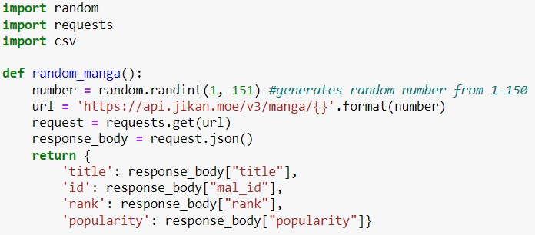
Code

Slide 7
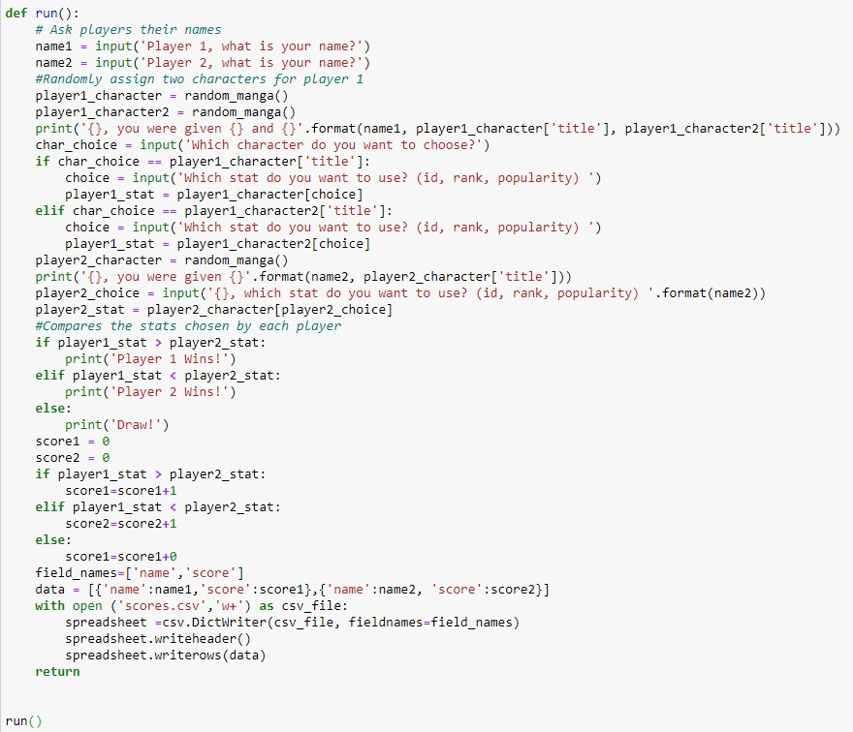

Slide 8
Extensions
Add an option to play alone against a computer
Option to show the highest score list

Slide 9

Github

